Slide 1
Comic Book Selfies
Bridget Cave
Spring 2017
bcave3@gatech.edu
Computational Photography @ GT

Slide 2
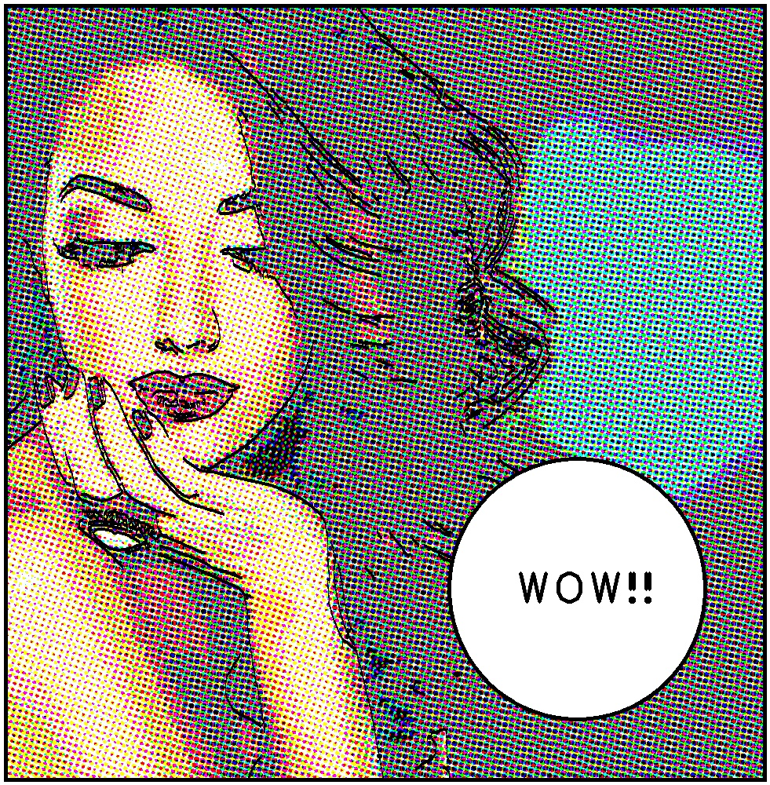
Comic Book Selfies

Slide 3
Input Image
Halftone Image
Output Image
Posterize Filter
Edge Filter
Speech Bubble
Pipeline
Computational Photography @ GT

Slide 4
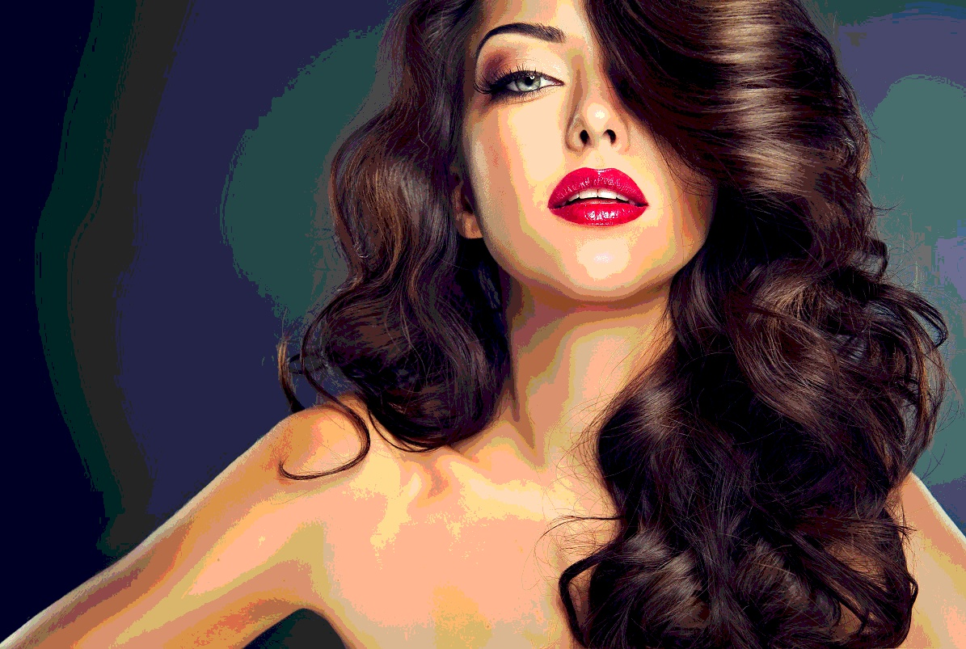
Posterize Filter
Posterization is the process of converting gradation of tone to several regions of fewer tones, creating abrupt changes from one tone to the next.
Photoshop does this by quantizing each channel individually (reducing the number of distinct colors).
Computational Photography @ GT

Slide 5

Halftone Image
Rather than continuous tones, halftone images are created by a series of dots. In this case, the dots represent the different channels of a CMYK image and their size is representative of intensity.
Computational Photography @ GT

Slide 6
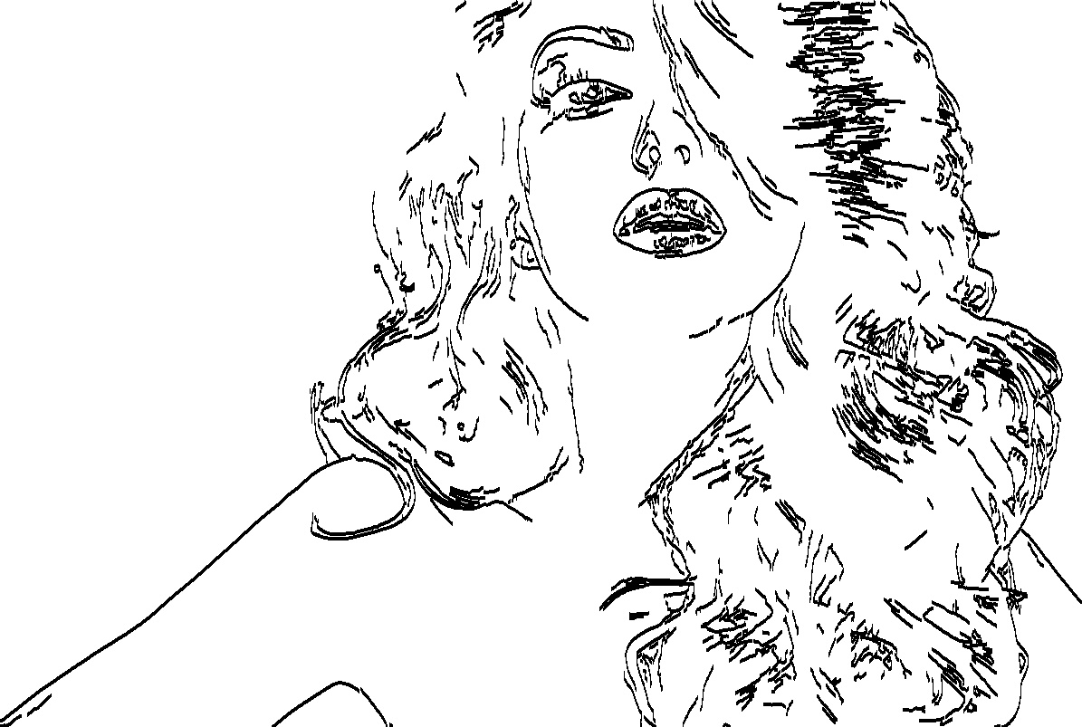
Edge Filter
Edge detection is a method that finds where there are abrupt changes in brightness.
I used Canny Edge Detection to create an Edge Map and took the inverse of this to create my Edge Filter than shows the edges of an image in black.
Computational Photography @ GT

Slide 7
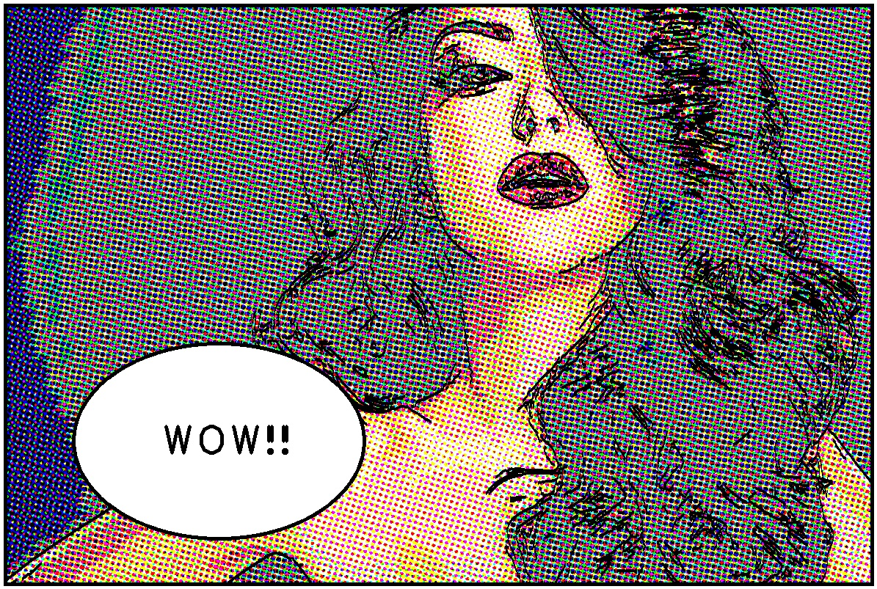
Add Speech Bubble Using Feature Detection
I used feature detection to find the front of a face and then add a speech bubble in the lower quadrant opposite of the face.
This will work as long as a face is detected, otherwise no bubble will be added.
Computational Photography @ GT

Slide 8


Result Set 1
Input
Output
Computational Photography @ GT

Slide 9

Result Set 2
Input
Output
Computational Photography @ GT

Slide 10

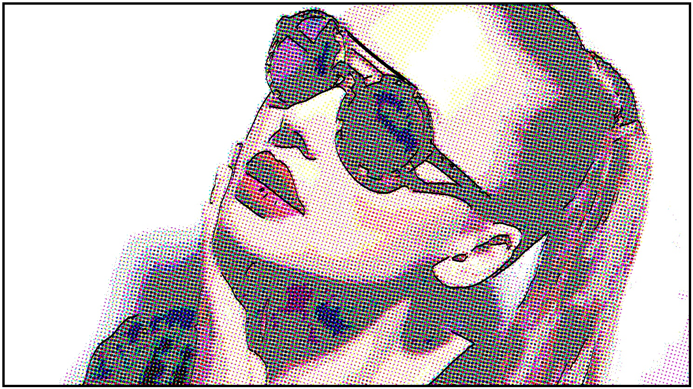
Result Set 3
Input
Output
Computational Photography @ GT

